Slide 1
CPSC3300: Computer Systems Organization
Lecture 5 – Combinational Logic

Slide 2
Outline
Reading for this lecture
8.1-3
Logic gates and functions
Truth table
Boolean algebra
Two-level representation (sum of product)
Example combinational logic devices
Mux and deMux
Adder

Slide 3
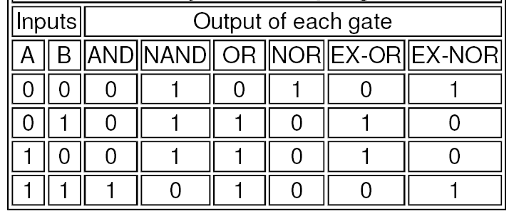
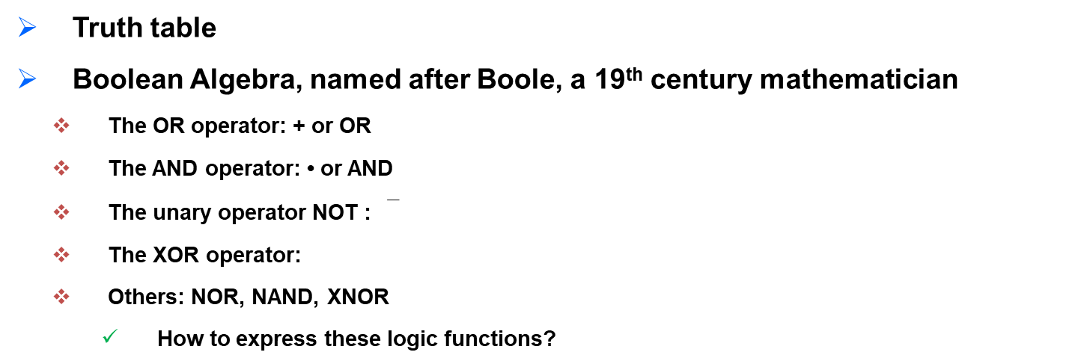
Express Logic Function
Truth table
Boolean Algebra, named after Boole, a 19th century mathematician
The OR operator: + or OR
The AND operator: • or AND
The unary operator NOT :
The XOR operator:
Others: NOR, NAND, XNOR
How to express these logic functions?
+

Slide 4

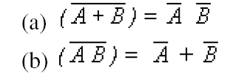
Laws of Boolean Algebra
T1 : Commutative Law
(a) A + B = B + A (b) A B = B A
T2 : Associate Law
(a) (A + B) + C = A + (B + C) (b) (A B) C = A (B C)
T3 : Distributive Law
(a) A (B + C) = A B + A C (b) A + (B C) = (A + B) (A + C)
T4 :
(a) 0 + A = A (b) 1 A = A
T5 :
(a) 1 + A = 1
(b) 0 A = 0
T6:
DeMorgan’s Theorem

Slide 5
Switch
This circuit is built with power, switch, and wires
For the electric circuit shown by the schematic diagram
Switch open, lamp off
Switch close, lamp on
When the switch is closed, the path is completed, current flows, and the lamp lights.
The voltage at position out can be 5v or 0v, depending on the state of the switch.
5V
out
Transistors are electric switches that operate fast

Slide 6
Logic Gates
Binary numbers in computers represented with voltage ranges
3.7v-5v: high
0v-1.3v: low
These two states can be reliably distinguished
Computer circuits include resistors, power, wires, and logic gates
Logic gates:
Built of transistors
process signals which represent true or false
Logic states:
True/false; 1/0; high/low; on/off
Logic gates
Name: NOT, AND, NAND
Symbols
Truth table or boolean operation, expressing the function

Slide 7







Logic Gates
NOT
AND
OR
XOR
NAND
NOR
XNOR
Name and symbols
Why are there so many gates?
Abstraction.
We want our digital logic diagrams to be clear, so we want different symbols for each function.

Slide 8
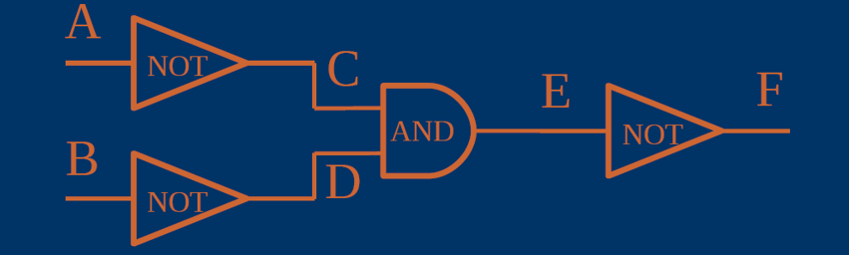
The Logic Gate Game
F = ?
F = $\overline{E}= \overline{C∙D}=\overline{\overline{A}∙\overline{B}}$
F = $\overline{E}= \overline{C∙D}=\overline{\overline{A}∙\overline{B}}= \overline{\overline{A}}+\overline{\overline{B}}=A+B$

Slide 9
Literal, Minterm, SOP
Definition:
A variable x_{i} has two literals: x_{i} and ‾x_{i}.
A logical product where each variable is represented by at most one literal is
a product or
a product term or
a term.
A minterm is a logical product of n literals where each variable occurs as exactly one literal
A canonical SOP (sum-of-products) is a logical sum of minterms, where all minterms are different.

Slide 10

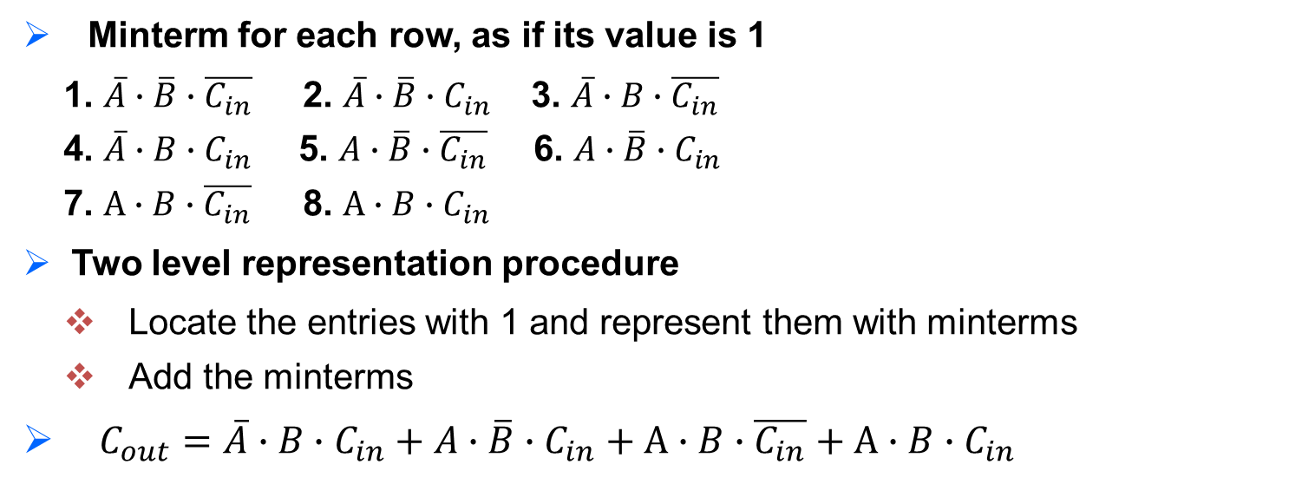
Logic Functions in Two-Level Representation
SoP can be used to determine the logic functions of variables
Example: identify the function for C_{out}
Given 3 variables A, B, C_{in}, #literals?
6 literals: A, B, C_{in}, $\overline{A}$, $\overline{B}$, $\overline{C_{in}}$
What are the minterms with three variables?
How to determine the function?
input |  |  | output
A | B | C_{in} | C_{out}
0 | 0 | 0 | 0
0 | 0 | 1 | 0
0 | 1 | 0 | 0
0 | 1 | 1 | 1
1 | 0 | 0 | 0
1 | 0 | 1 | 1
1 | 1 | 0 | 1
1 | 1 | 1 | 1
Minterm for each row, as if its value is 1
1. $\overline{A}∙\overline{B}∙\overline{C_{in}}$ 2. $\overline{A}∙\overline{B}∙C_{in}$ 3. $\overline{A}∙B∙\overline{C_{in}}$
4. $\overline{A}∙B∙C_{in}$5. $A∙\overline{B}∙\overline{C_{in}}$6. $A∙\overline{B}∙C_{in}$
7. $A∙B∙\overline{C_{in}}$ 8. $A∙B∙C_{in}$
Two level representation procedure
Locate the entries with 1 and represent them with minterms
Add the minterms
$C_{out}=\overline{A}∙B∙C_{in}+A∙\overline{B}∙C_{in}+A∙B∙\overline{C_{in}}+A∙B∙C_{in}$

Slide 11
Multiplexers
A n-1 multiplexer, or MUX, for short, is a device that allows you to pick one of n inputs and direct it to an output
Examples:
TV: you select one of many channels to be displayed on your screen
Radio:
An n-1 MUX consists of the following:
Data inputs: n
Control inputs: ceil( log₂ n ) (– what is this?)
Output: 1
Diagram of 2-1 MUX
Data inputs: n=2 (y0, x0)
Control inputs: ceil( log₂ 2 )=1;C: 1 bit
Outputs: 1
y0
x0
y0
x0
2-1MUX
C
C
Z
Z

Slide 12
2-1 MUX cont’d
x1
x0
Behavior of 2-1 MUX
If c==0, then x₀ is directed to the output z
If c==1, then x₁ is directed to the output z
Truth table
Boolean Expression:
Implement it with logic gates by yourself
1
2-1MUX
0
Row | C | X1 | X0 | Z
0 | 0 | 0 | 0 | 0
1 | 0 | 0 | 1 | 1
2 | 0 | 1 | 0 | 0
3 | 0 | 1 | 1 | 1
4 | 1 | 0 | 0 | 0
5 | 1 | 0 | 1 | 0
6 | 1 | 1 | 0 | 1
7 | 1 | 1 | 1 | 1
Z
Row | C | Z
0 | 0 | X0
1 | 1 | X1

Slide 13
Binary Addition
(0)₁₀ = ( )₂
(1)₁₀ = ( )₂
(2)₁₀ = ( )₂
(3)₁₀ = ( )₂
(4)₁₀ = ( )₂
(5)₁₀ = ( )₂
(6)₁₀ = ( )₂
(7)₁₀ = ( )₂
(8)₁₀ = ( )₂
Let's consider adding two 3-bit UB (unsigned binary) numbers.
1 1 0
+ 0 1 1
-----------

Slide 14
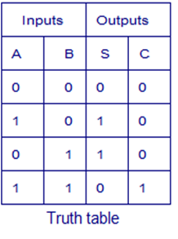
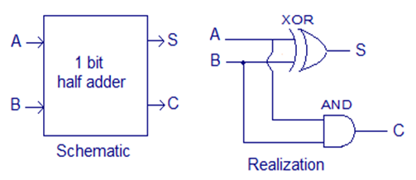
Machine Addition
Consider adding two bits (binary digits) together:
A + B = ?
0 + 0 = 0
0 + 1 = 1
1 + 0 = 1
1 + 1 = 10
S is for “SUM”
C is for “CARRY”
C = AND(A, B)
S = XOR(A, B)
Half Adder
add two 1-digit addends, can only be
used to add the least significant bit (can’t deal
with a carry-in bit from the lower digit)

Slide 15
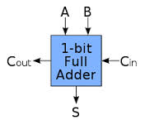
Full Adder
A half Adders does not handle carries
A full adder can handle three bits
– 3 data inputs: X, Y, and C_{in}
– 2 outputs: S for sum and C_{out} for carry out
Truth table?
Boolean expression?
Circuits?
A | B | C_{in}
0 | 0 | 0
0 | 0 | 1
0 | 1 | 0
0 | 1 | 1
1 | 0 | 0
1 | 0 | 1
1 | 1 | 0
1 | 1 | 1
C_{out} | S
0 | 0
0 | 1
0 | 1
1 | 0
0 | 1
1 | 0
1 | 0
1 | 1
C_{out} | S

Slide 16
Summary
Truth table
Boolean algebra
Mux
Adders
Reading for next lecture
5th ed: 8.5-6

